Slide 1
NLP Restaurant Chatbot Development using Dialogflow
Version 1.0
Group Id: F24PROJECT5D341 (BC210402852,BC210424799)
Supervisor Name : Abdullah Qamar

Slide 2
Introduction of project
The Restaurant Chatbot is a cutting-edge conversational AI tool designed to enhance the dining experience by providing efficient and automated interactions with customers. It integrates seamlessly into restaurant operations, offering services such as real-time table reservations, personalized menu navigation, order placements, ultimately driving both customer satisfaction and business efficiency.

Slide 3
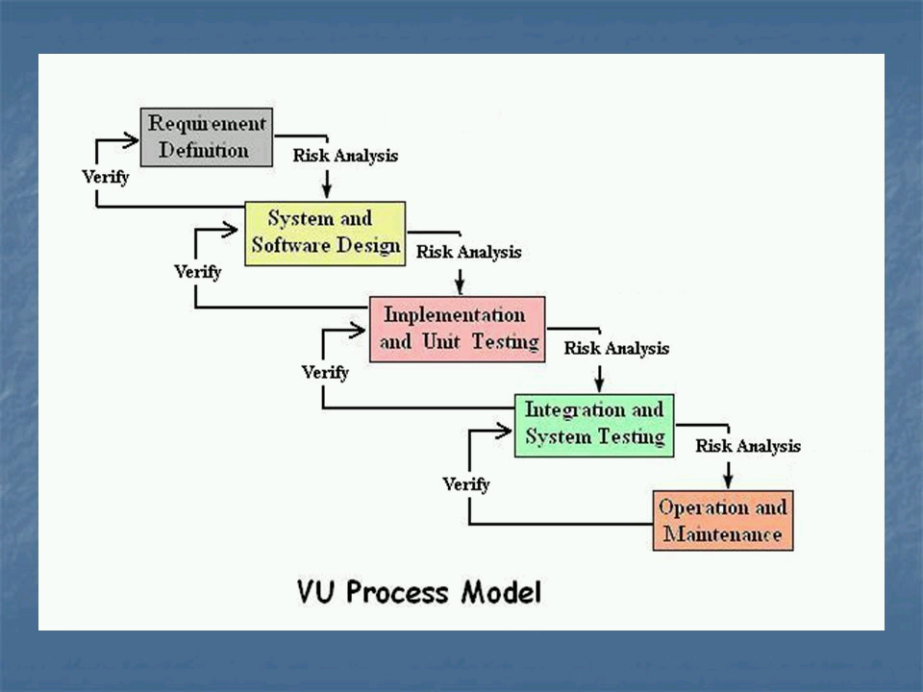
Adopted Methodology
VU Process Model

Slide 4
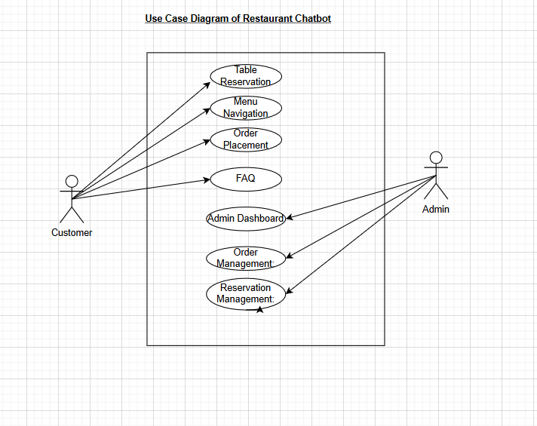
Usecase Diagram

Slide 5
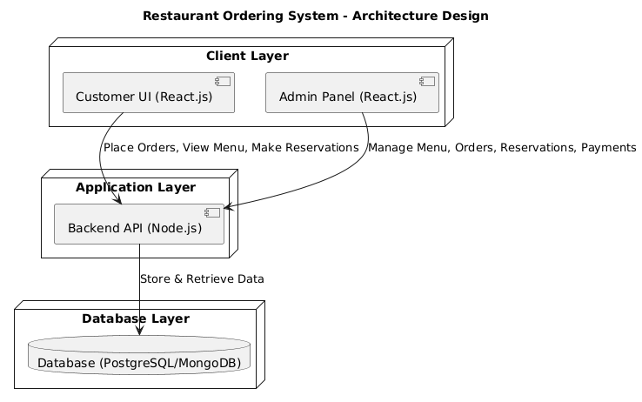
Architecture Diagram

Slide 6
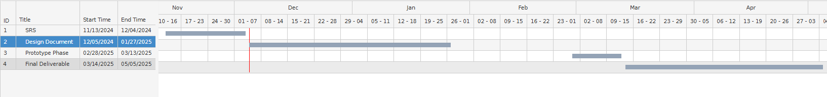
Project Schedule/Workplan

Slide 7
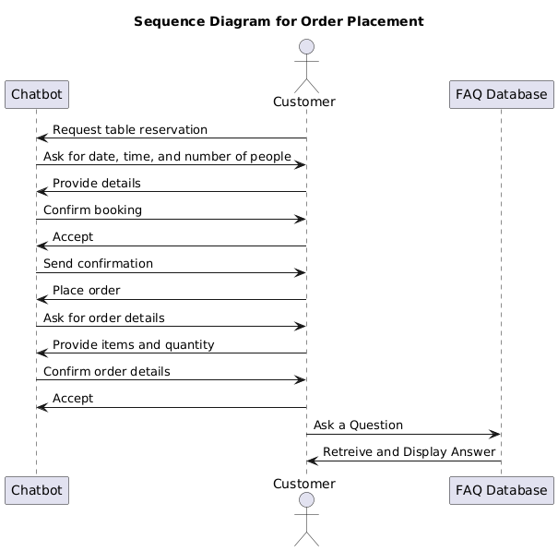
Sequence Diagram

Slide 8
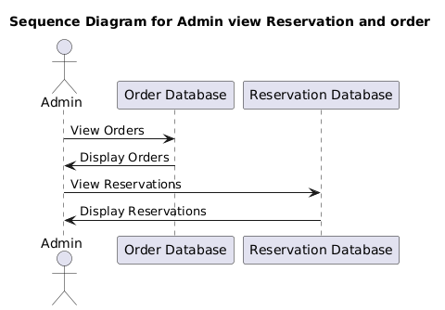

Slide 9
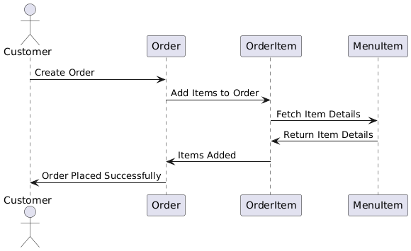

Slide 10
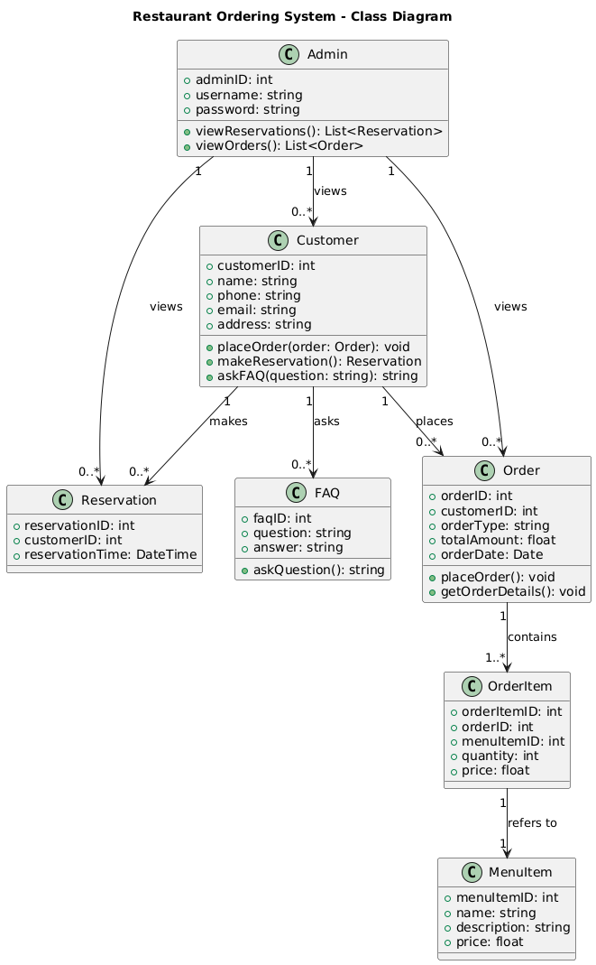
Primary Objectives

Slide 11
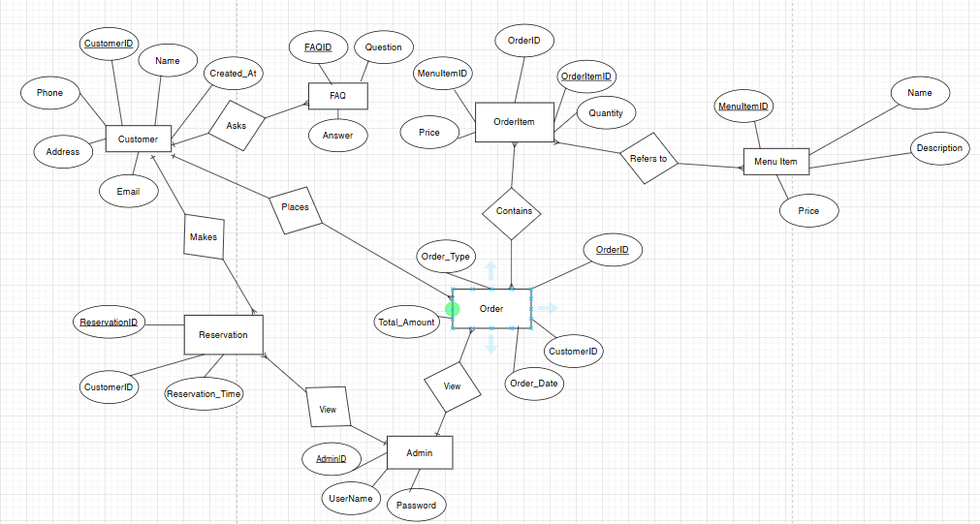
ERD Diagram

Slide 12
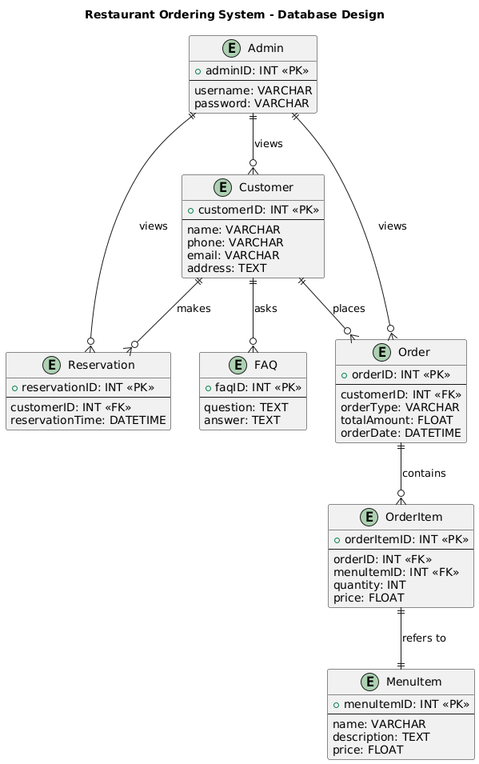
Database Diagram

Slide 13
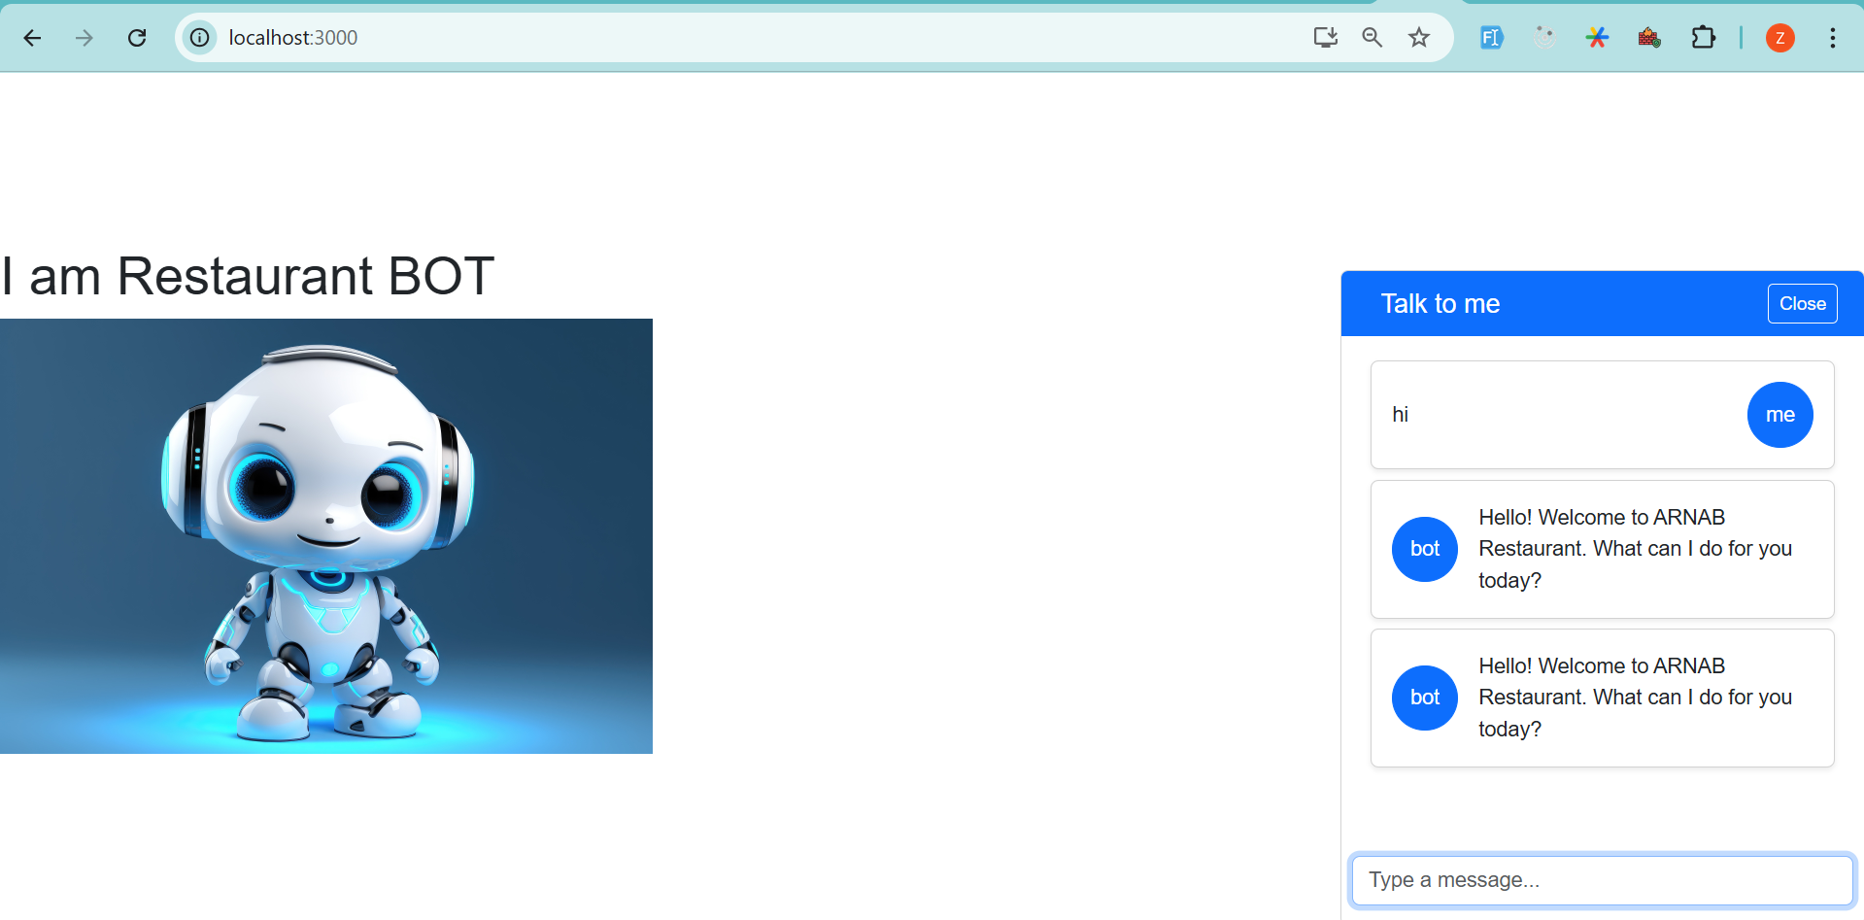
GUI Screenshot

Slide 14
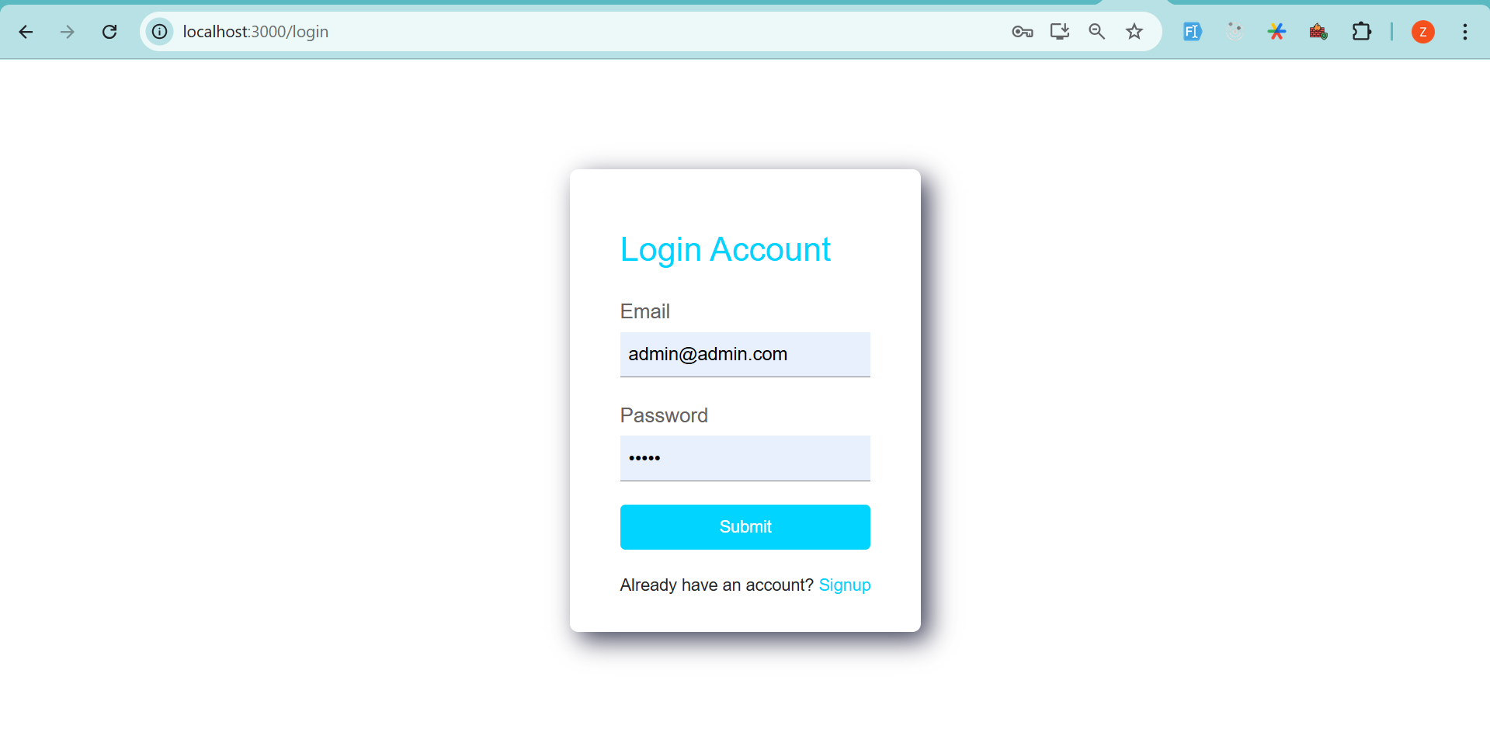

Slide 15
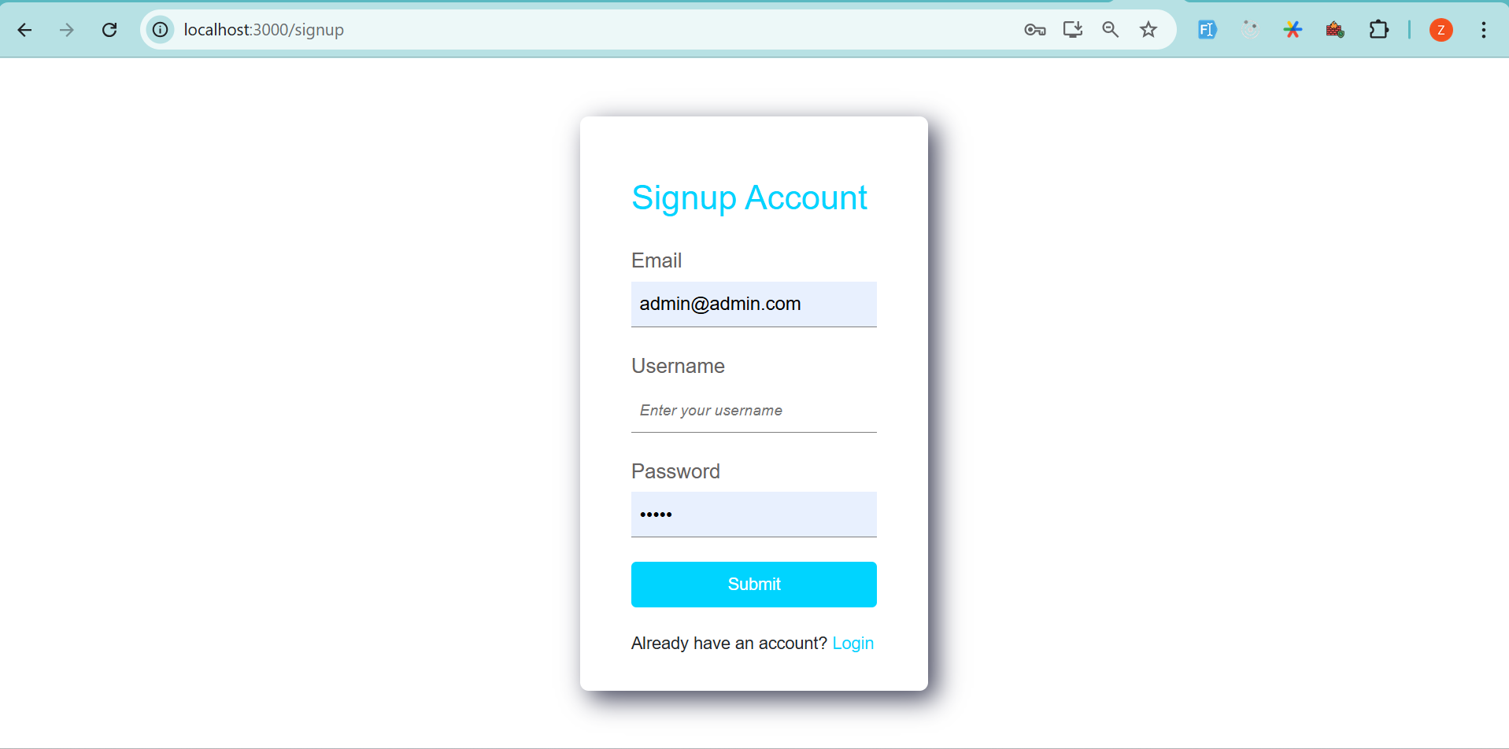

Slide 16
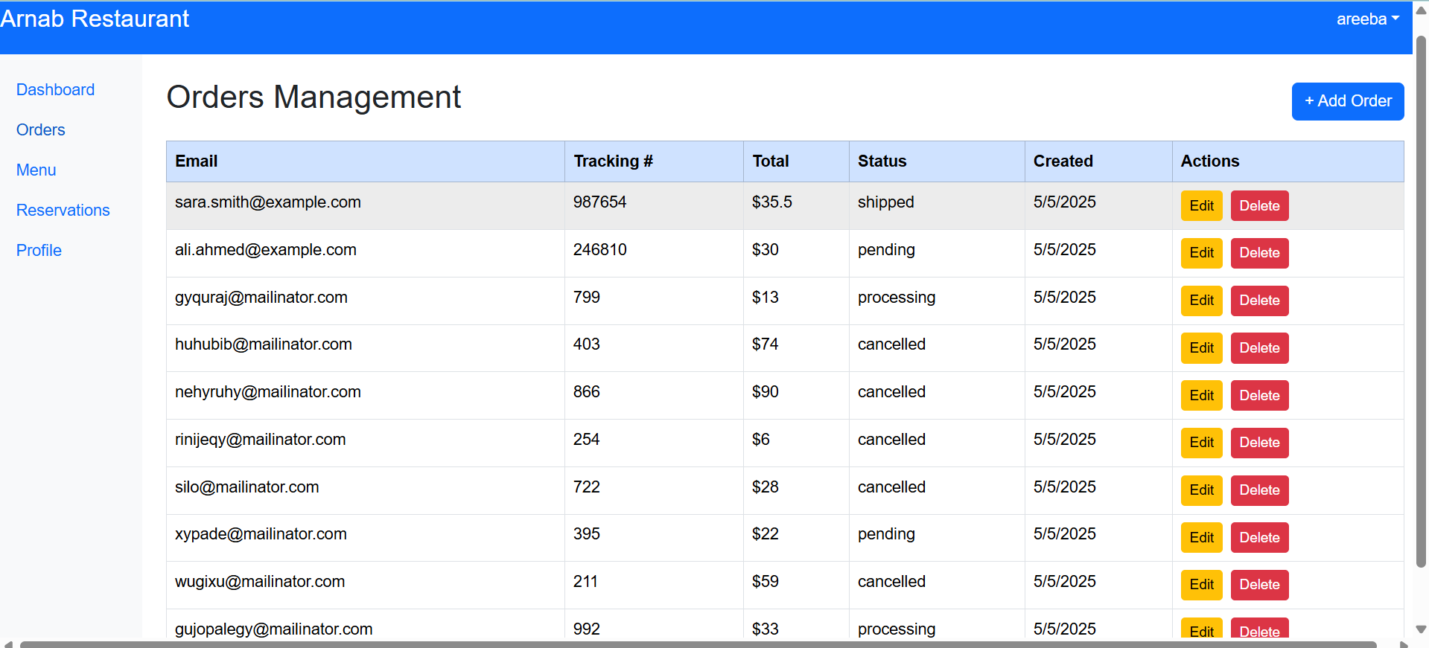

Slide 17
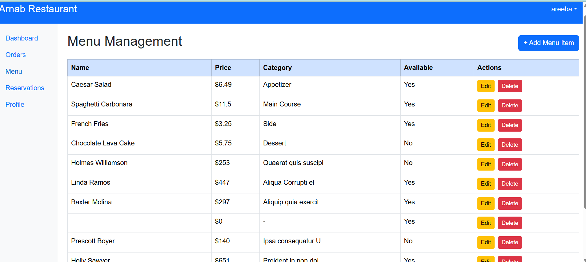

Slide 18
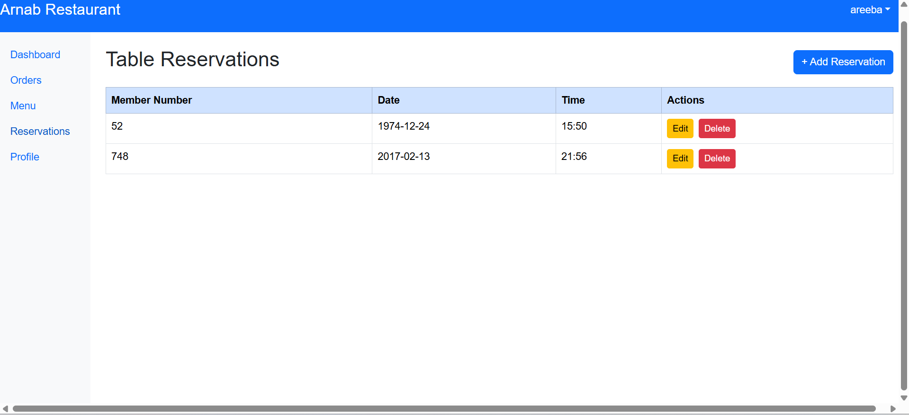

Slide 19
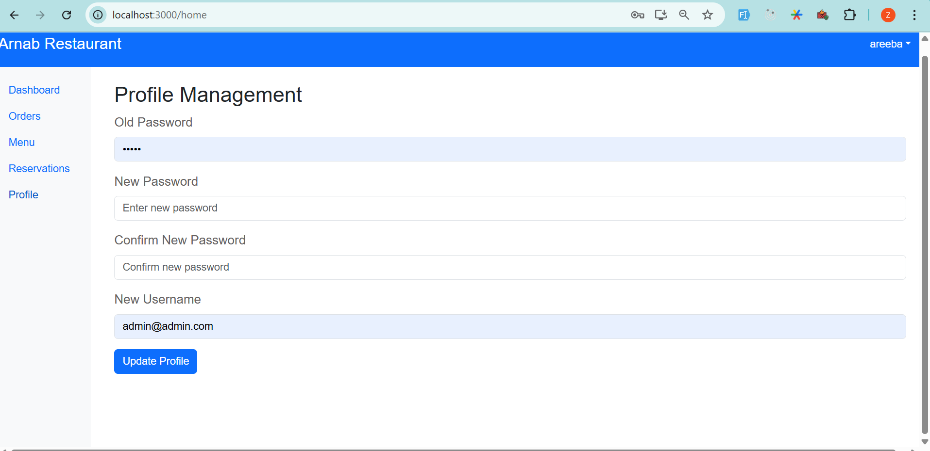

Slide 20
Tools
Development Tools: Node.js, Dialogflow, React.js, Express
Database: Mongodb Compass
Version Control: Github
Testing Tools: Postman

Slide 21

Thank You

